Slide 1

Data Visualization CSIS 3860 Term Project
SUDARSAN HARIDAS
300353099

Slide 2
Contribution
Suchul Kim : Power BI workbook, Documentation Word File
Sudarsan Haridas (me) - Tableau Workbook, Power BI (video explanation)

Slide 3
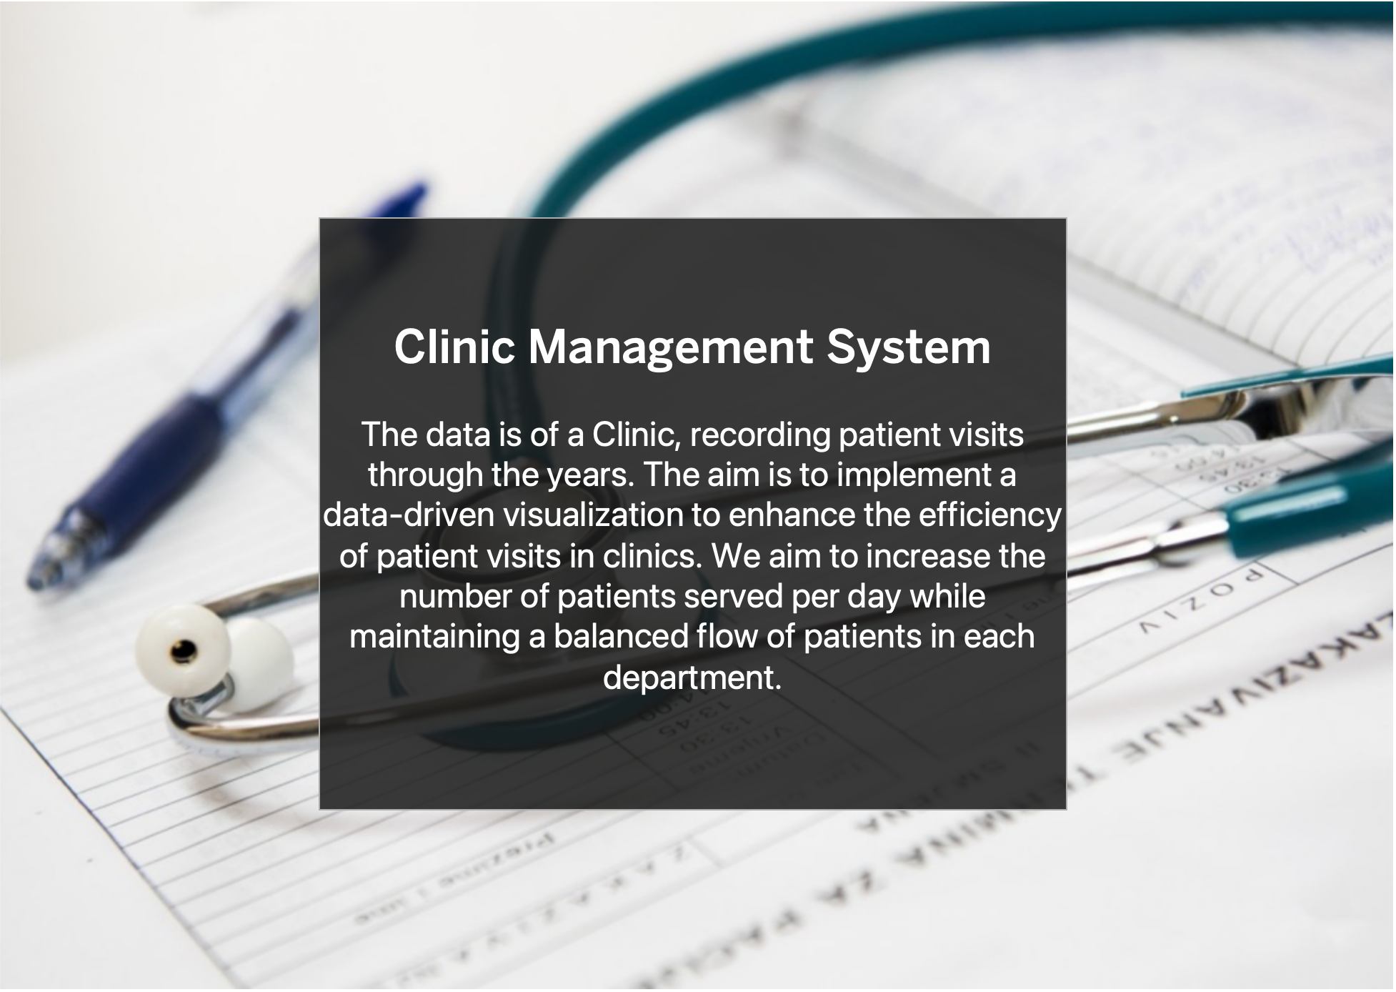

Slide 4
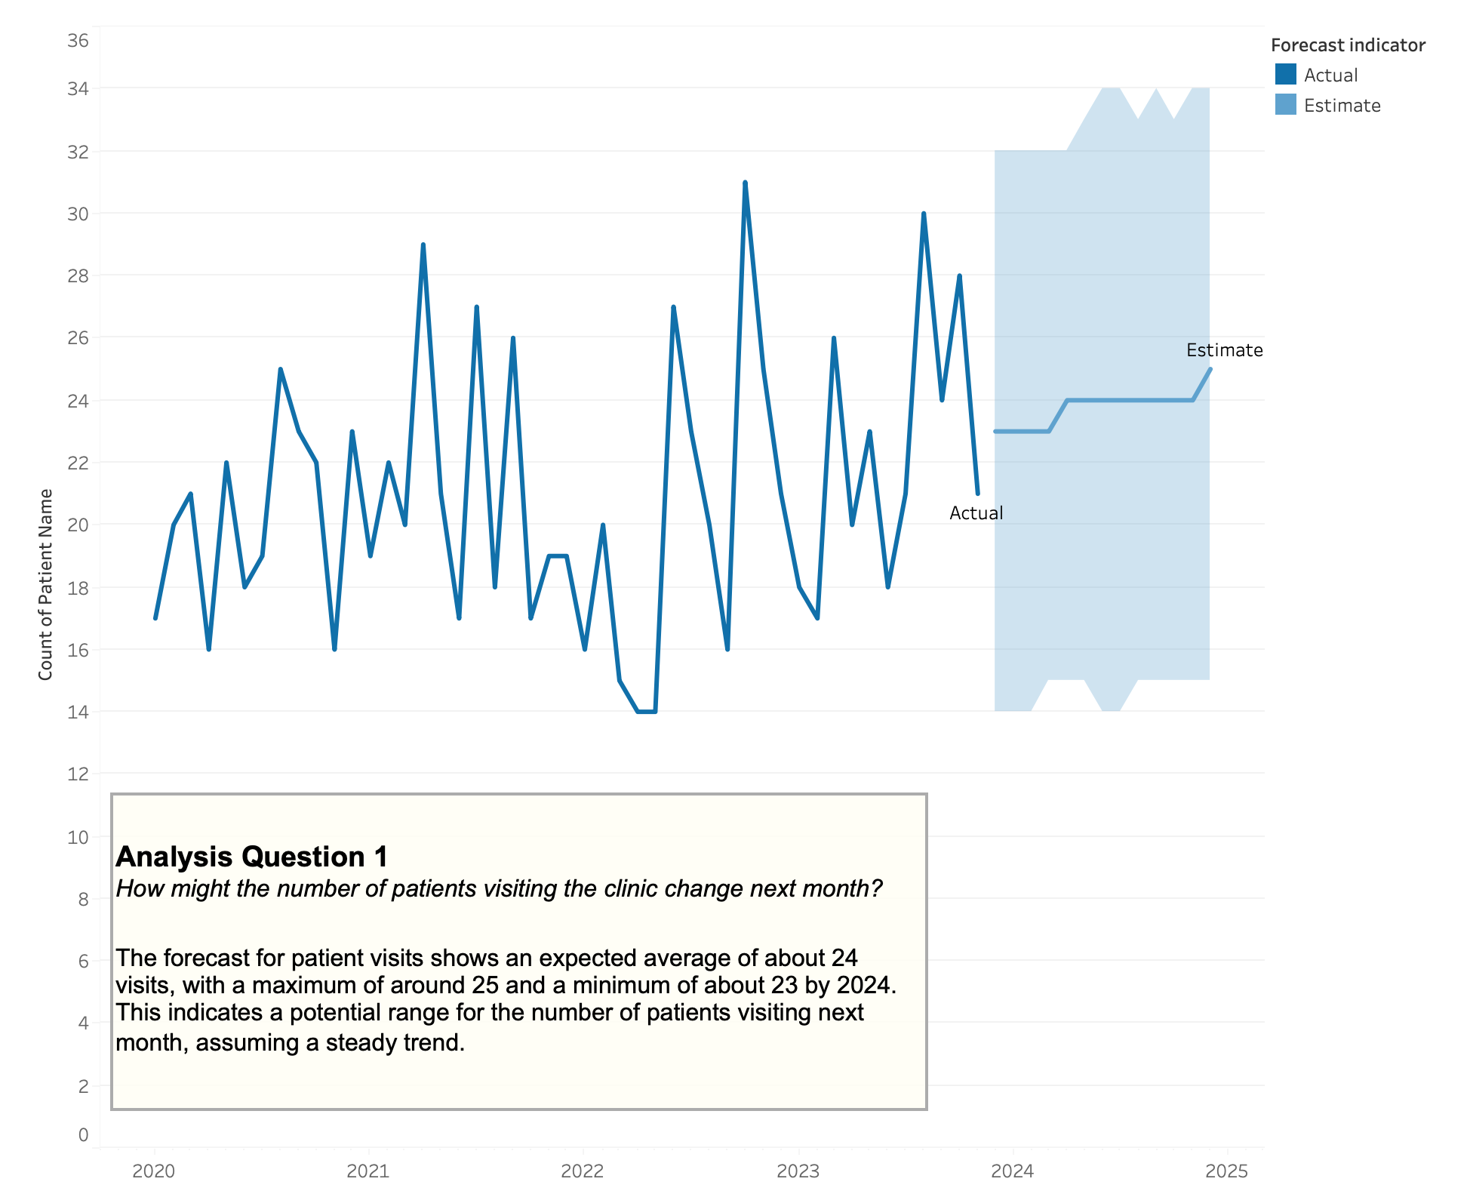

Slide 5
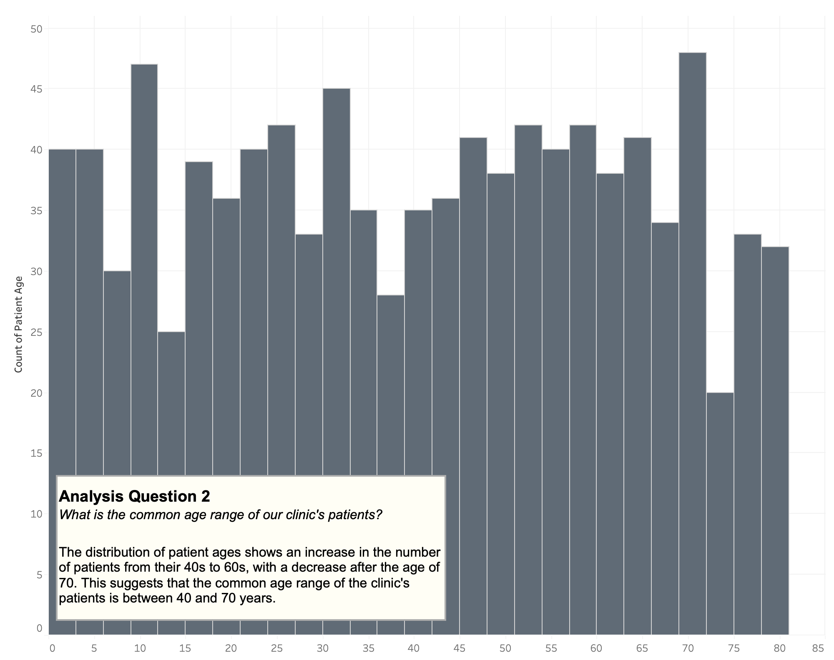

Slide 6
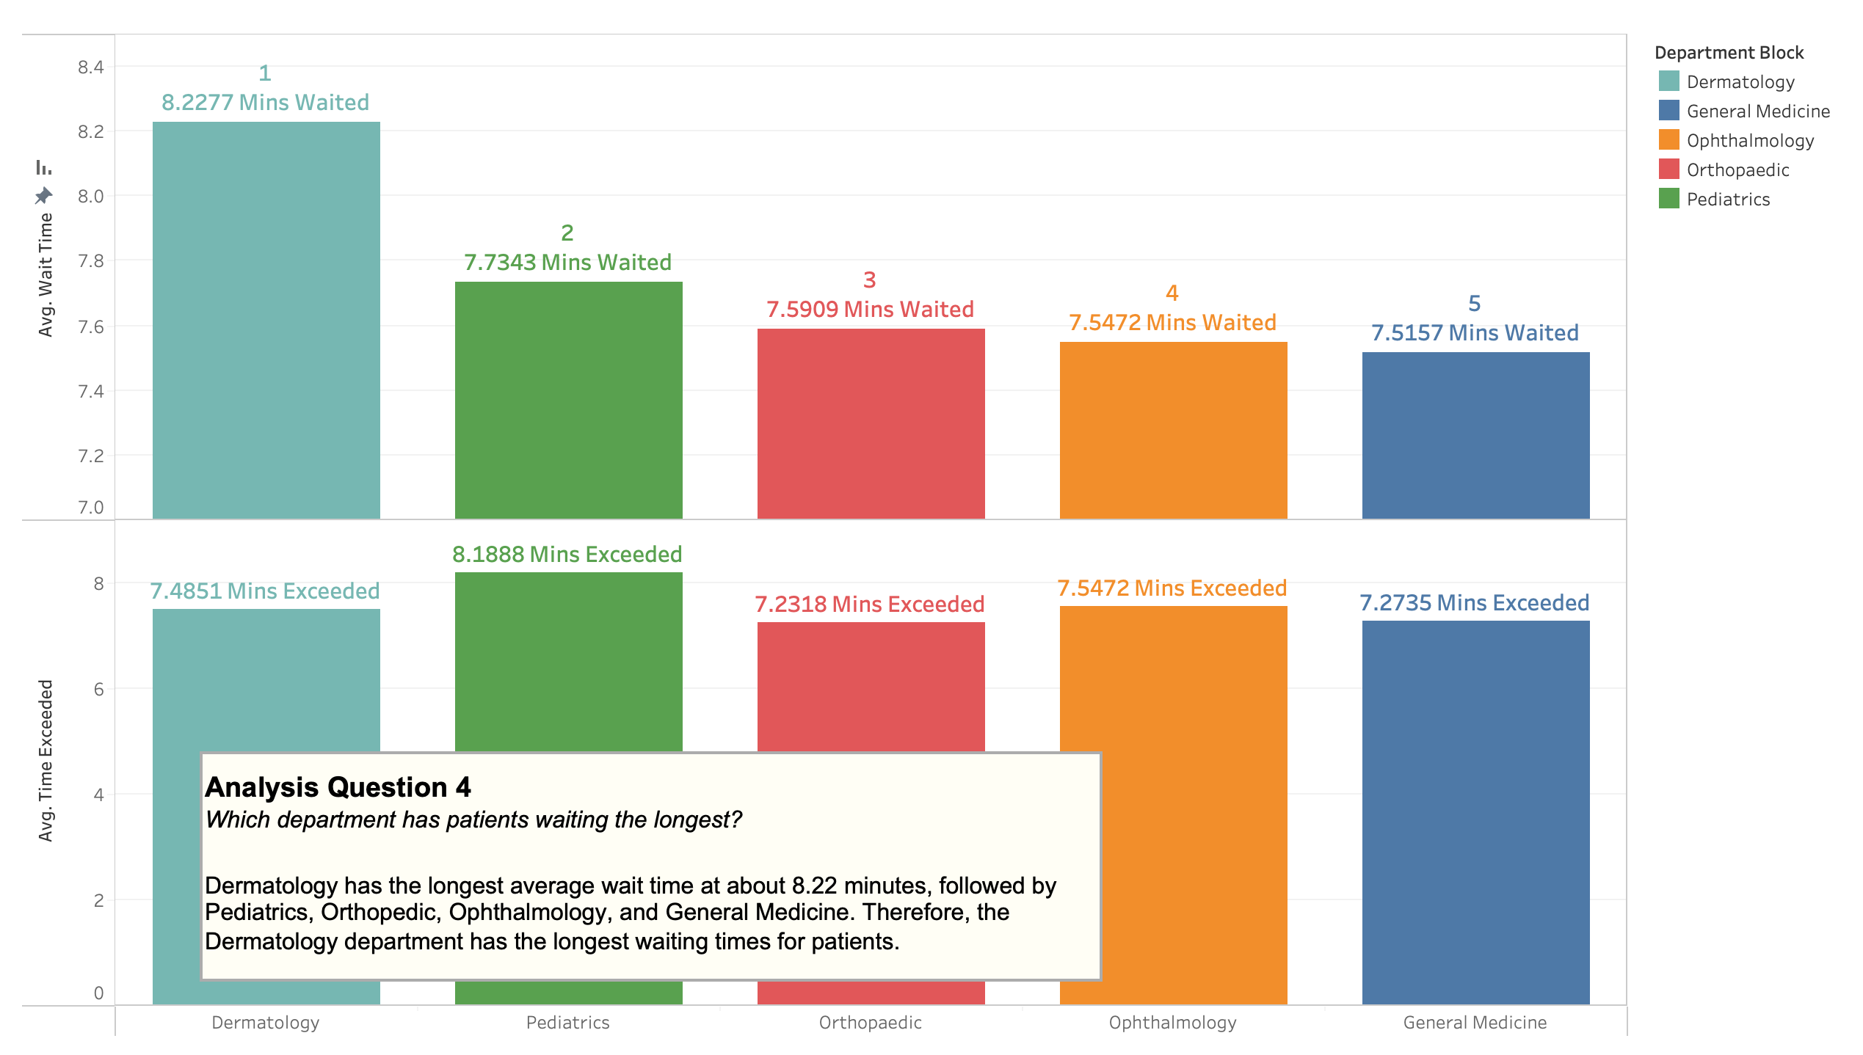

Slide 7
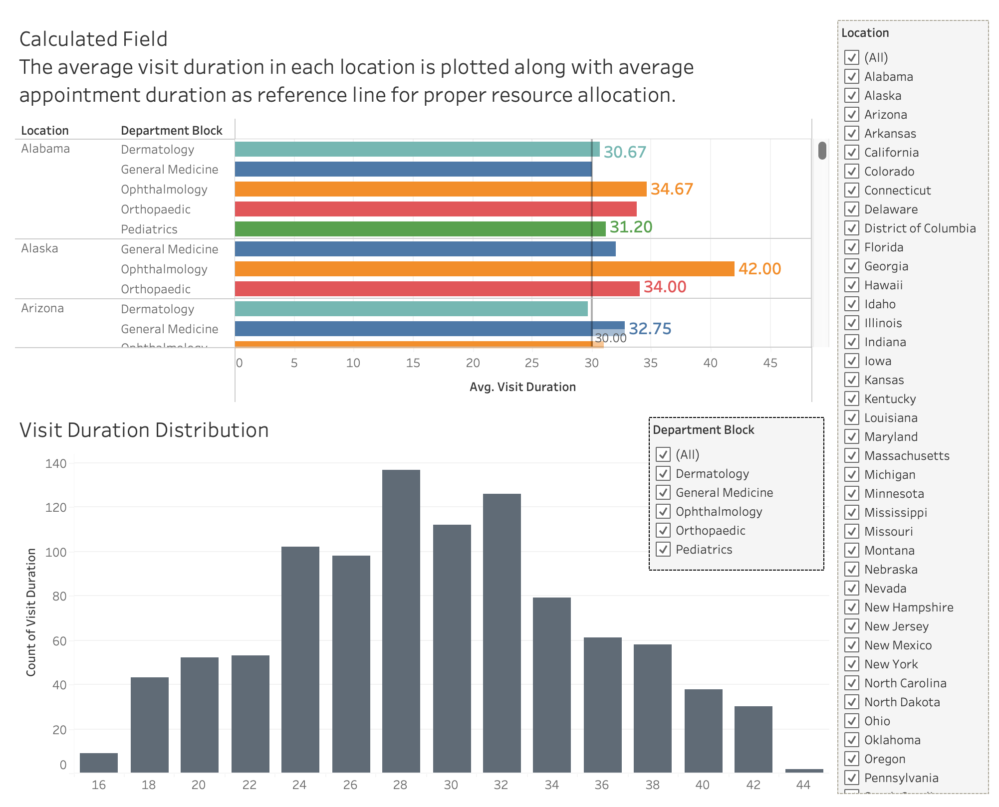

Slide 8
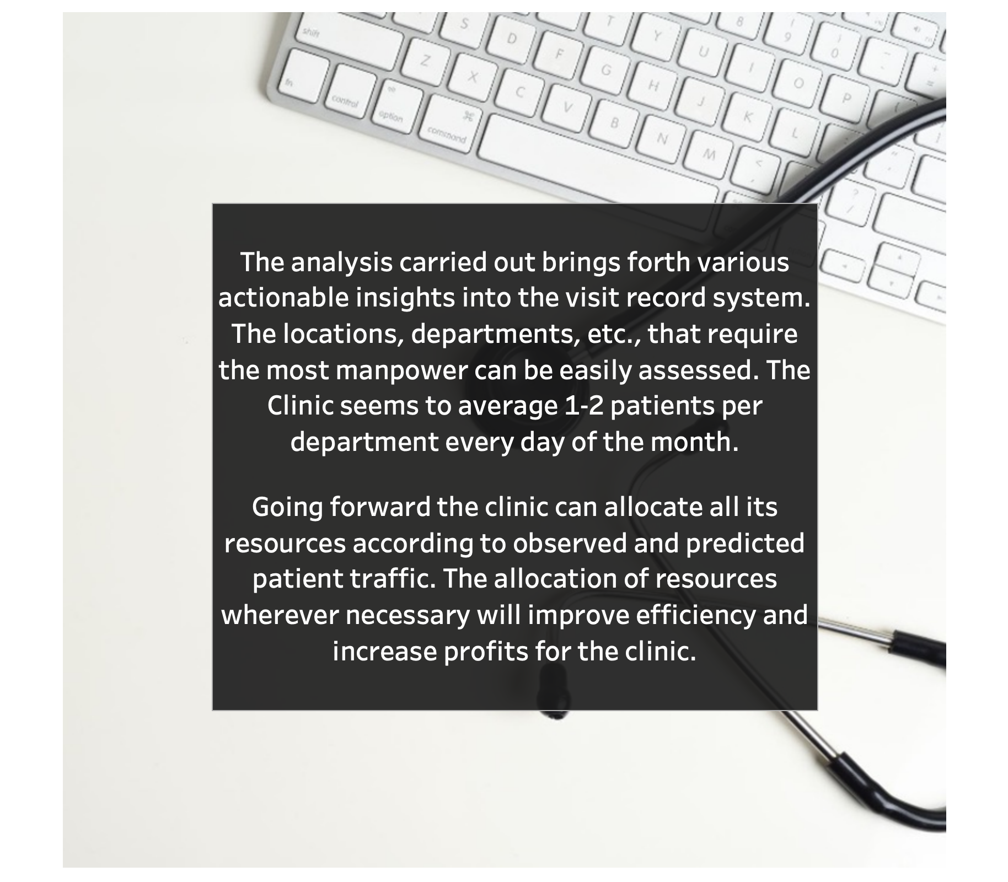
CONCLUSION

Slide 9
References
Tableau Desktop and Web Authoring Help
https://help.tableau.com/current/pro/desktop/en-us/calculations_tablecalculations.htm
Learning Tableau 2022 – 5th Edition by Joshua Milligan ISBN 9781801072328 – Packt Publishing - eBook available from publisher’s website and/or Book store (https://www.packtpub.com/product/learning-tableau-2022-fifth-edition/9781801072328)

